Slide 2
Finding Max subarray using divide and conquer
Presented by Ali Osama;
ID_221487;

Slide 3
Table of Content
Defining the problem
Why divide and conquer
Steps for solving the problem
Coding of solution to the problem using python
Time analysis using recurrence
Comparing it to other algorithms
Why choosing the right strategy is important
Conclusion

Slide 4

Defining the problem
Given array to function
-1
-2
6
-4
2
3
2
-1
Returned max subarray = 9
6
-4
2
3
2

Slide 5
Defining the problem
Given array to function
-1
-2
6
-4
2
3
2
-1
Returned max subarray = 9
6
-4
2
3
2

Slide 6

why divide and conquer

Slide 7
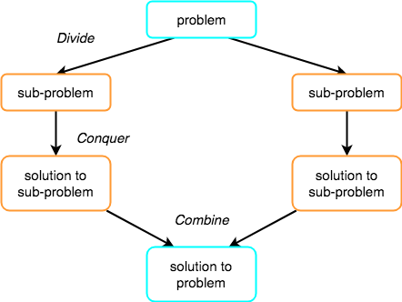
why divide and conquer

Slide 8
Steps by step approach
Step 1 Divide and Conquer Approach:
Step 2 Recursive Exploration:
Break problem into smaller subproblems.
Apply algorithm
recursively to left and right.
Explore maximum subarrays in smaller segments.
Step 3 Identify Cross Subarray:
Calculate middle index (midpoint)
Find max sub array crossing the middle.
Step 4 Combine and Return:
Compare maximum subarrays of left, right, and cross.
Return the maximum subarray among the three.
Split the array into left and right halves.

Slide 9
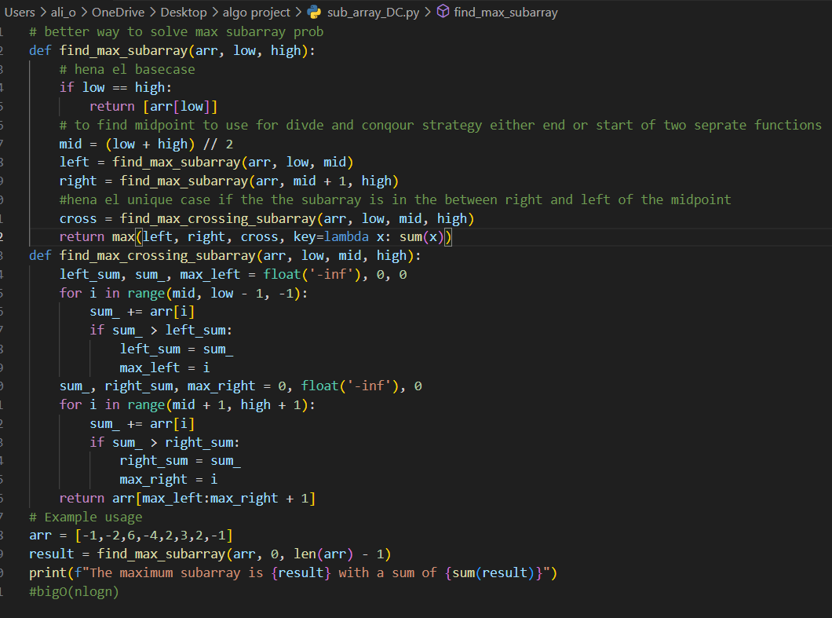
Coding using
Python

Slide 10
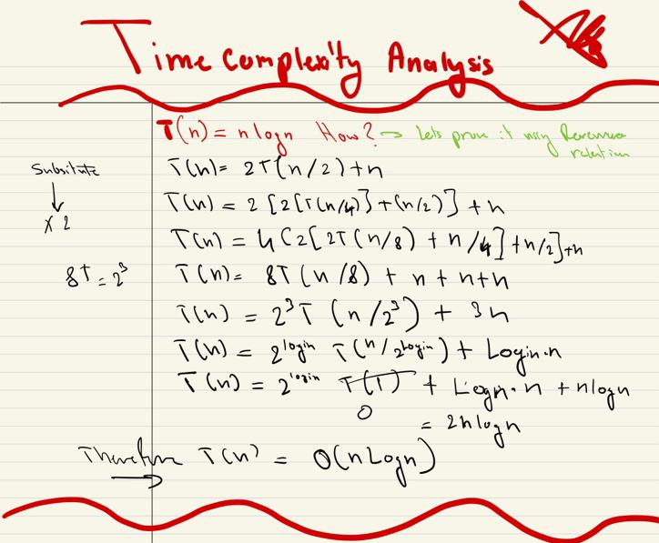
Time Analysis Using Recurrence

Slide 11
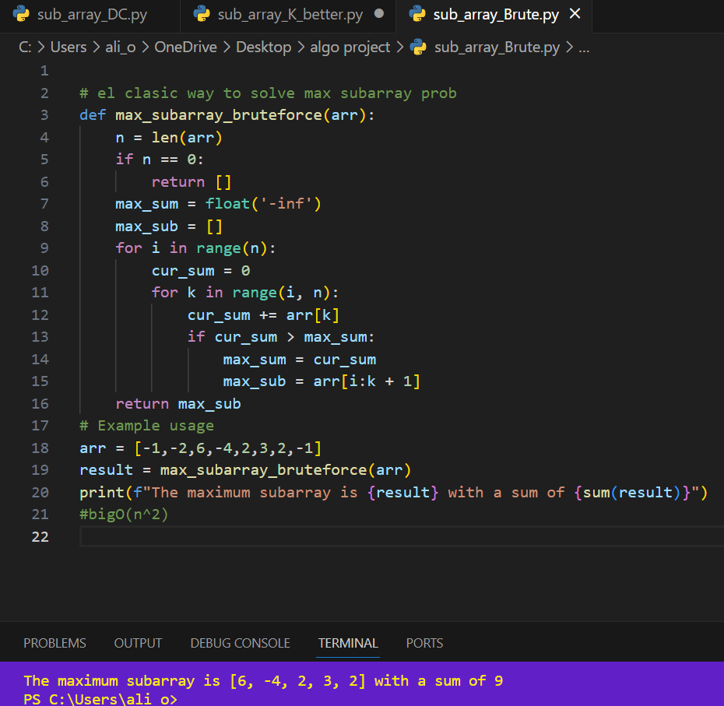
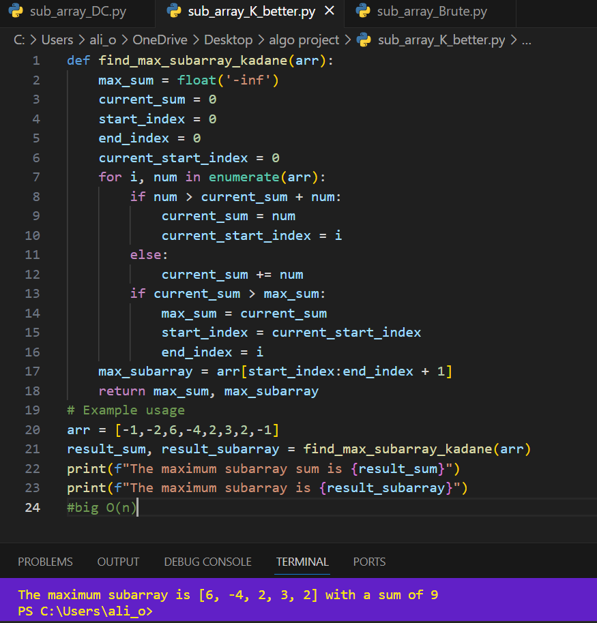

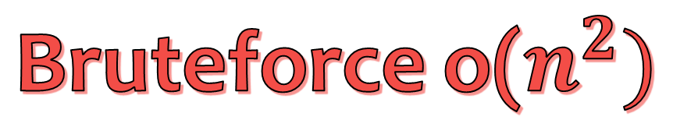
Comparing DC to other algorithms
Bruteforce o($n^{2})$
Kadane O($n$)

Slide 12
why is choosing the right algorithmic strategy important?
Game Development: In strategy games, the maximum subarray problem optimizes decisions for unit and resource allocation, ensuring efficient gameplay.
Financial Data Analysis: In finance, the maximum subarray problem analyzes stock prices, identifying profitable periods for buying and selling stocks.
Image Processing: Image processing uses the maximum subarray problem to identify areas of interest or patterns in images by analyzing contiguous regions.

Slide 13
Resources
Maximum subarray: divide and conquer. (n.d.). Stack Overflow. https://stackoverflow.com/questions/14638561/maximum-subarray-divide-and-conquer
mycodeschool. (2014, June 23). Maximum sum sub-array [Video]. YouTube. https://www.youtube.com/watch?v=ohHWQf1HDfU
GeeksforGeeks. (2023, September 18). Maximum Subarray Sum using Divide and Conquer algorithm. https://www.geeksforgeeks.org/maximum-subarray-sum-using-divide-and-conquer-algorithm/
ChatGPT. (n.d.). https://chat.openai.com/

